Slide 1
Summarizing Data Collected in the Sample
CHAPTER 4

Slide 2
Learning Objectives (1 of 3)
Distinguish between dichotomous, ordinal, categorical, and continuous variables
Identify appropriate numerical and graphical summaries for each variable type
Compute a mean, median, standard deviation, quartiles and range for a continuous variable

Slide 3
Learning Objectives (2 of 3)
Construct a frequency distribution table for dichotomous, categorical, and ordinal variables
Provide an example of when the mean is a better measure of location than the median
Interpret the standard deviation of a continuous variable

Slide 4
Learning Objectives (3 of 3)
Generate and interpret a box plot for a continuous variable
Produce and interpret side-by-side box plots
Differentiate between a histogram and a bar chart

Slide 5
Variable Types
Dichotomous variables have two possible responses (e.g., yes/no).
Ordinal and categorical variables have more than two responses, and responses are ordered and unordered, respectively.
Continuous (or measurement) variables assume in theory any values between a theoretical minimum and maximum.

Slide 6
Biostatistics
Two areas of applied biostatistics
Descriptive statistics—summarize a sample selected from a population
Inferential statistics—make inferences about population parameters based on sample statistics.

Slide 7
Vocabulary
Data elements/data points
Subjects/units of measurement
Population versus sample

Slide 8
Sample vs. Population
Any summary measure computed on a sample is a statistic.
Any summary measure computed on a population is a parameter.
n = Sample Size
N = Population Size

Slide 9
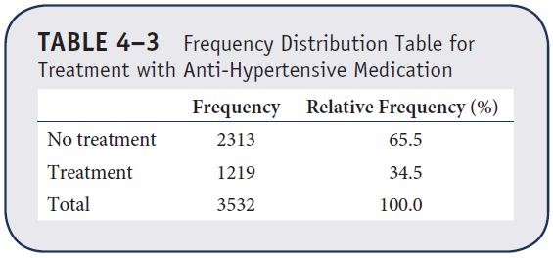
Example 4.1. Dichotomous Variable
Frequency Distribution Table

Slide 10
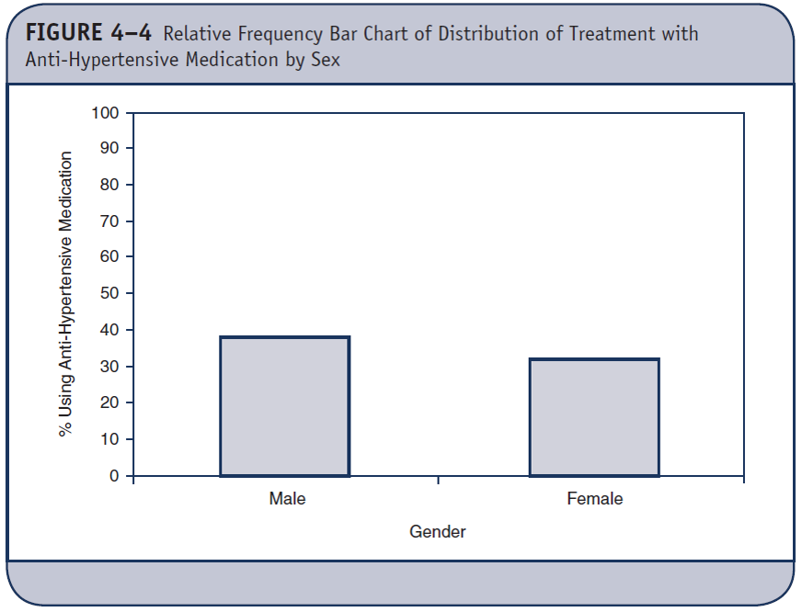
Relative Frequency Bar Chart for Dichotomous Variable

Slide 11
Categorical Outcome (1 of 2)
Sample: n = 50
Population: Patients at health center
Variable: Marital status
Marital Status | Number of Patients
Married | 24
Separated | 5
Divorced | 8
Widowed | 2
Never married | 11
Total | 50

Slide 12
Categorical Outcome (2 of 2)
Frequency Distribution Table
Marital Status | Number of Patients (f) | Relative Frequency (f/n)
Married | 24 | 0.48
Separated | 5 | 0.10
Divorced | 8 | 0.16
Widowed | 2 | 0.04
Never married | 11 | 0.22
Total | 50 | 1.00

Slide 13
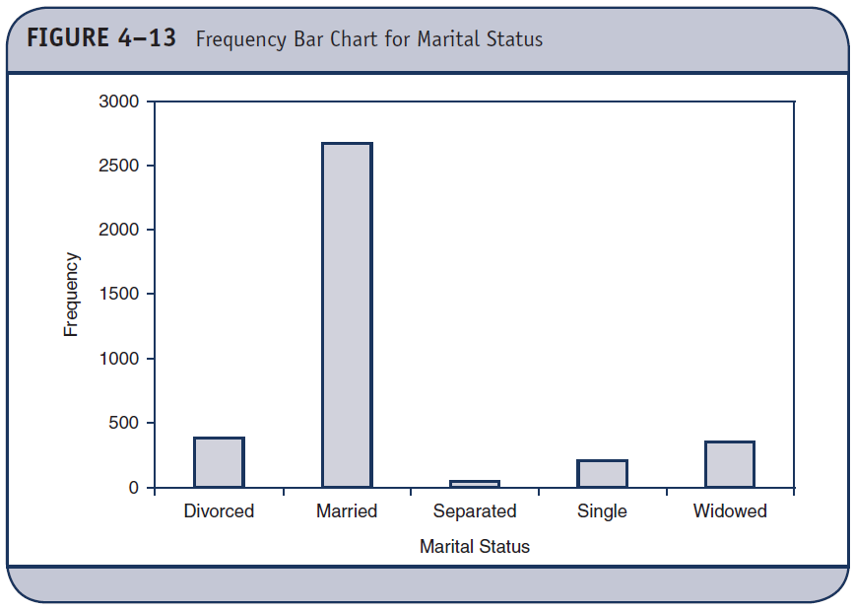
Frequency Bar Chart

Slide 14
Ordinal Outcome (1 of 2)
Sample: n =50
Population: Patients at health center
Variable: Self-reported current health status
Health Status | Number of Patients
Excellent | 19
Very good | 12
Good | 9
Fair | 6
Poor | 4
Total | 50

Slide 15
Ordinal Outcome (2 of 2)
Frequency Distribution Table
Heath Status | Freq. | Rel. Freq. | Cumulative Freq. | Cumulative Rel. Freq.
Excellent | 19 | 38% | 19 | 38%
Very good | 12 | 24% | 31 | 62%
Good | 9 | 18% | 40 | 80%
Fair | 6 | 12% | 46 | 92%
Poor | 4 | 8% | 50 | 100%
 | 50 | 100%

Slide 16
Relative Frequency Histogram

Slide 17
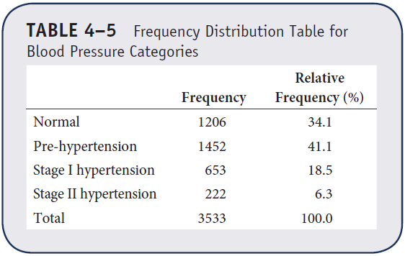
Example 4.2. Ordinal Variable
Frequency Distribution Table

Slide 18
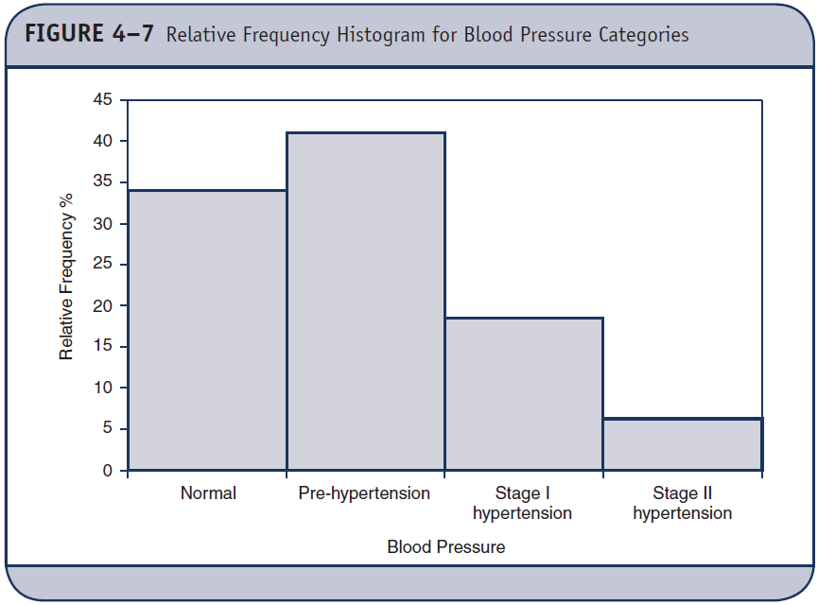
Relative Frequency Histogram for Ordinal Variable

Slide 19
Continuous Variable (1 of 9)
Assume, in theory, any value between a theoretical minimum and maximum
Quantitative, measurement variables

Slide 20
Continuous Variable (2 of 9)
Population: Patients 50 years of age with coronary artery disease
Sample: n = 7 patients
Outcome: Systolic blood pressure (mmHg)

Slide 21
Continuous Variable (3 of 9)
Sample data
X 100 110 114 121 130
130 160

Slide 22
Continuous Variable (4 of 9)
X 100 110 114 121 130
130 160

Slide 23
Continuous Variable (5 of 9)
Consider a second sample from the same population.
We record SBP on each subject in the second sample:
120 121 122 124 125 126 127
n = 7
= 865 / 7 = 123.6.
What is different between the two samples?

Slide 24
Continuous Variable (6 of 9)
Dispersion
X | (X – )
100 | –23.6
110 | –13.6
114 | –9.6
121 | –2.6
130 | 6.4
130 | 6.4
160 | 36.4
865 | 0

Slide 25
Continuous Variable (7 of 9)
Dispersion
Mean absolute
deviation (MAD):
X | (X – )
100 | –23.6
110 | –13.6
114 | –9.6
121 | –2.6
130 | 6.4
130 | 6.4
160 | 36.4
865 | 0

Slide 26
Continuous Variable (8 of 9)
Sample variance
X (X – ) (X – )²
^{100 –23.6 556.96}
^{110 –13.6 184.96}
^{114 –9.6 92.16}
^{121 –2.6 6.76}
^{130 6.4 40.96}
^{130 6.4 40.96}
^{160 36.4 1324.96}
^{865 0 2247.72}

Slide 27
Continuous Variable (9 of 9)
Sample standard deviation
Standard summary
n = 7, X = 123.6, s = 19.4

Slide 28
Median
Median—holds 50% of values above and 50% of values below
Order data
For n odd—median is middle value
For n even—median is mean of two middle values
100 110 114 121 130 130 160
Median

Slide 29
Quartiles
Q₁ = first quartile holds approximately 25% of the scores at or below it.
Q₃ = third quartile holds approximately 25% of the scores at or above it.
Q₂ = ??

Slide 30
Continuous Variable
Order data
100 110 114 121 130 130 160
Q₁
Median
Q₃

Slide 31
Box and Whisker Plot
100 110 120 130 140 150 160
Min Q1 Median Q3 Max

Slide 32
Comparing Samples with Box and Whisker Plots
100 110 120 130 140 150 160

Slide 33
Summarizing Location and Variability
When there are no outliers, the sample mean and standard deviation summarize location and variability.
When there are outliers, the median and interquartile range (IQR) summarize location and variability, where IQR = Q₃ – Q₁.

Slide 34
Example (1 of 2)
Sample: n = 51 participants in a study of cardiovascular risk factors.
Variable: age (years)
60 62 63 64 64 65 65 65 65 65 65
66 66 66 66 66 67 67 67 68 68 68
70 70 70 71 71 72 72 73 73 73 73
73 73 75 75 75 76 76 77 77 77 77
79 82 83 85 85 87

Slide 35
Example (2 of 2)
Sample mean:
Sample variance:
Sample standard deviation:
Standard summary: n = 51, X = 71.3, s = 6.4

Slide 36
Outliers
IQR = Interquartile Range = Q₃ – Q₁
= Range of middle half of the data
Outliers are values that either:
Exceed Q₃ + 1.5 IQR
Fall below Q₁ – 1.5 IQR
Or, are outside ± 3s

Slide 37
Check for Outliers in Example
Q₁ = 66, Q₃ = 76, IQR = 10
Lower = 66 – 1.5(10) = 51
Upper = 76 + 1.5(10) = 91
± 3s = 52.1 to 90.5

Slide 38
Presenting Data (1 of 2)
Suppose we collapse ages into five mutually exclusive and exhaustive categories
Age Class Number of Individuals (freq.) 60–64 5
65–69 17
70–74 12
75–79 12
80–84 2
85–89 3

Slide 39
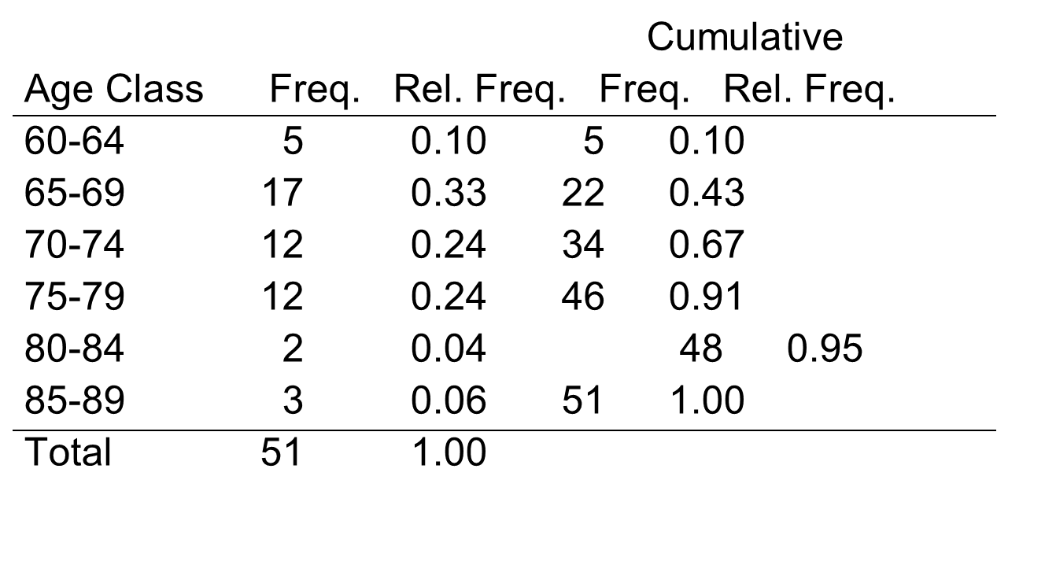
Presenting Data (2 of 2)

Slide 40
Frequency Histogram

Slide 41
Example 4.3. Summarizing Continuous Variables
Diastolic blood pressures in n = 10 randomly selected participants attending the seventh examination of the Framingham Offspring Study
76 64 62 81 70
72 81 63 67 77

Slide 42
Summarizing Location
What is a typical diastolic blood pressure?
Sample mean:
= Sum of diastolic blood pressures/n
= 713/10 = 71.3

Slide 43
Notation
Let X represent the outcome of interest (e.g., X = diastolic blood pressure)

Slide 44
Summarizing Variability
Sample range:
= maximum – minimum = 81 – 62 = 19
Sample variance:

Slide 45
Sample Variance (1 of 2)
DBP Deviation from Mean
76 (76 – 71.3) = 4.7
64 (64 – 71.3) = –7.3
62 (62 – 71.3) = –9.3
81 9.7
70 –1.3
72 0.7
81 9.7
63 –8.3
67 –4.3
77 5.7
S X = 71.3 S Deviations from Mean = 0

Slide 46
Sample Variance (2 of 2)
DBP Deviation from Mean Squared Deviations
76 (76 – 71.3) = 4.7 22.09
64 (64 – 71.3) = –7.3 53.29
62 (62 – 71.3) = –9.3 86.49
81 9.7 94.09
70 –1.3 1.69
72 0.7 0.49
81 9.7 94.09
63 –8.3 68.89
67 –4.3 18.49
77 5.7 32.49
Σ X = 71.3 Σ Deviations = 0 Σ Deviations² = 472.10

Slide 47
Sample Variance and Sample Standard Deviation

Slide 48
Median
Median holds 50% of values above and 50% of values below
Order data
For n odd—median is middle value
For n even—median is mean of two middle values
Median = 71
62 63 64 64 70 | 72 76 77 81 81

Slide 49
Quartiles
Q₁ = first quartile holds 25% of values below it
Q₃ = third quartile holds 25% of values above it
Median = 71
62 63 64 64 70 | 72 76 77 81 81
Q₁ Q₃

Slide 50
Determining Outliers
Outliers—values below Q₁ – 1.5(Q₃ – Q₁) or above Q₃ + 1.5(Q₃ – Q₁)
In Example 4.3: lower limit = 64 – 1.5(77 – 64) = 44.5 and upper limit = 77 + 1.5(77 – 64) = 96.5
Outliers?
Mean or median?
s or IQR?

Slide 51
Box Plot for Continuous Variable

Slide 52
Numerical and Graphical Summaries (1 of 2)
Dichotomous and categorical
Frequencies and relative frequencies
Bar charts (freq. or relative freq.)
Ordinal
Frequencies, relative frequencies, cumulative frequencies, and cumulative relative frequencies
Histograms (freq. or relative freq.)

Slide 53
Numerical and Graphical Summaries (2 of 2)
Continuous
Mean, standard deviation, minimum, maximum, range, median, quartiles, interquartile range
Box plot

